Slide 1
CS 179: GPU Programming
Lecture 5: Synchronization and ILP

Slide 2
Announcement
Because of the large number of students enrolled in this course, we are changing how to submit labs for this course. Instead of emailing us with a zip file of your README and code, we are going to utilize Titan for set submission.
Instead of emailing us the solution, put a zip file in your home directory on Titan, in the format:
lab[N]_2019_submission.zip
Your submission should be a single archive file (.zip) with your README file and all code.
Even if you've already emailed us with your lab 1 submission, you still need to put the zip file on Titan.

Slide 3
Last time...
GPU Memory System
Global Memory: the slowest and largest form of memory on the GPU, shared by all grids
Coalesced memory access minimizes the number of cache lines read
Shared Memory: very fast memory, located on the SM and shared by the block
Setup as 32 banks that can be accessed in parallel. Each successive 32-bit words are assigned to successive banks
A bank conflict occurs when 2 threads in a warp access different elements in the same bank
Registers: fasted memory possible, located on the SM, scope is the thread
Local Memory: located on the Global Memory, scope is the thread
L1/L2/L3 Cache
Texture and Constant Cache
Notes:
I’ll mention shared memory a few more times in this lecture. shared memory is user programmable cache on SM.

Slide 4
This lecture
Synchronization
Atomic Operations
Instruction Dependencies
Instruction Level Parallelism (ILP)
Warp Scheduler
Occupancy

Slide 5
Synchronization
Ideal case for parallelism:
no resources shared between threads
no communication needed between threads
However, many algorithms that require shared resources can still be accelerated by massive parallelism of the GPU.

Slide 6
Synchronization
Synchronization is a process by which multiple threads must indirectly communicate with each other in order to make sure they do not clash with each other
Example of synchronization issue:
int x = 1;
Thread 1: x += 1;
Thread 2: x += 1;
Thread 1 reads in the value of x (which is 1) into a register
Thread 2 reads in the value of x (which is still 1) into a register
Both threads increment the values they read in but they both think the final value is 2
They write x back out and the final result is 2

Slide 7
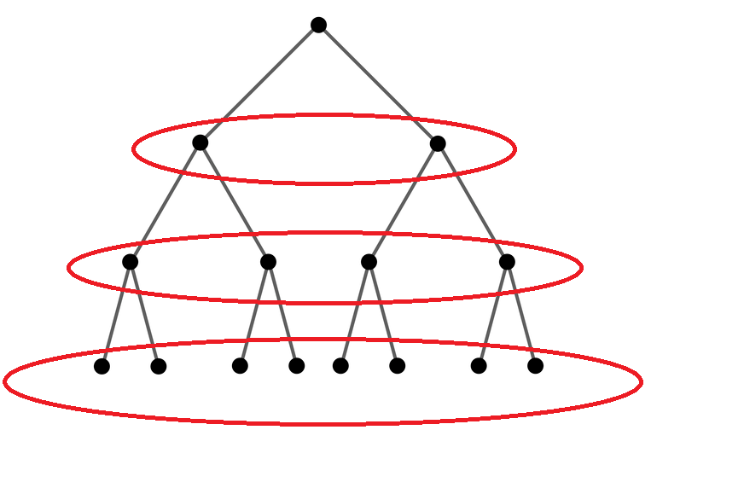
Synchronization
Examples needing synchronization:
Parallel BFS
Summing a list of numbers
Loading data into a GPU’s shared memory
Notes:
For the first example, I’m assuming a thread will touch elements in shared memory that were loaded by another thread.
We can’t start processing until we know all threads have finished loading their data into shared memory.
When summing a list of numbers, multiple threads/blocks all need to write to a single memory address. Need some synchronization.
dining philosophers

Slide 8
Synchronization
On a CPU, you can solve synchronization issues using Locks, Semaphores, Condition Variables, etc.
On a GPU, these solutions introduce too much memory and process overhead
We have simpler solutions better suited for parallel programs

Slide 9
CUDA Synchronization
Use the __syncthreads() function to sync threads within a block
Only works at the block level
SMs are separate from each other so can't do better than this
Similar to barrier() function in C/C++
This __synchthreads() call is very useful for kernels using shared memory.

Slide 10
Atomic Operations
Atomic Operations are operations that ONLY happen in sequence
For example, if you want to add up N numbers by adding the numbers to a variable that starts in 0, you must add one number at a time
Don't do this though. We'll talk about better ways to do this in the next lecture. Only use when you have no other options
Notes:
named because an atom is the “smallest unit” even though this isn’t really true.
atomic adds solve the problem of the previous slide

Slide 11
Atomic Operations
CUDA provides built in atomic operations
Use the functions: atomic<op>(float *address, float val);
Replace <op> with one of: Add, Sub, Exch, Min, Max, Inc, Dec, And, Or, Xor
e.g. atomicAdd(float *address, float val) for atomic addition
These functions are all implemented using a function called atomicCAS(int *address, int compare, int val)
CAS stands for compare and swap. The function compares *address to compare and swaps the value to val if the values are different
Notes:
named because an atom is the “smallest unit” even though this isn’t really true.
atomic adds solve the problem of the previous slide

Slide 12
Instruction Dependencies
An Instruction Dependency is a requirement relationship between instructions that force a sequential execution
In the example on the right, each summation call must happen in sequence because the value of acc depends on the previous summation as well
Can be caused by direct dependencies or requirements set by the execution order of code
I.e. You can't start an instruction until all previous operations have been completed in a single thread
acc += x[0];
acc += x[1];
acc += x[2];
acc += x[3];
...
Notes:
Instruction dependencies are important to think about for high performance computing on x86, Nvidia architectures.
This is just an unrolled for loop.

Slide 13
Instruction Level Parallelism (ILP)
Instruction Level Parallelism is when you avoid performances losses caused by instruction dependencies
Idea: we do not have to wait until instruction n has finished to start instruction n + 1
In CUDA, also removes performances losses caused by how certain operations are handled by the hardware

Slide 14
ILP Example
z0 = x[0] + y[0];
z1 = x[1] + y[1];
x0 = x[0];
y0 = y[0];
z0 = x0 + y0;
x1 = x[1];
y1 = y[1];
z1 = x1 + y1;
COMPILATION
The second half of the code can't start execution until the first half completes
Notes:
The x0 = x[0] lines indicate loading from memory into register, about 300 clocks.
Which instructions can overlap? Can we do better at overlapping instructions to hide latency?
HPC involves a lot of worrying about if the compiler is doing what you want.

Slide 15
ILP Example
z0 = x[0] + y[0];
z1 = x[1] + y[1];
x0 = x[0];
y0 = y[0];
x1 = x[1];
y1 = y[1];
z0 = x0 + y0;
z1 = x1 + y1;
COMPILATION
Sequential nature of the code due to instruction dependency has been minimized.
Additionally, this code minimizes the number of memory transactions required
Notes:
The x0 = x[0] lines indicate loading from memory into register, about 300 clocks.
Which instructions can overlap? Can we do better at overlapping instructions to hide latency?
HPC involves a lot of worrying about if the compiler is doing what you want.

Slide 16
Warp Schedulers
Warp schedulers find a warp that is ready to execute its next instruction and available execution cores and then start execution
GK110:
4 warp schedulers in each SM and 2 dispatchers in each scheduler
Can start instructions in up to 4 warps each clock and up to 2 subsequent, independent instructions in each warp.
Notes:
Each scheduler has 2 dispatchers.
Can start 2 instructions at once only if there are no instruction dependencies.
Note that it now takes up to 80 warp instructions to hide latency of warp add (10 cycles) rather than just 10 warp instructions.
GK110 has 15 SMs, so on a single clock up to 15 * 8 = 120 warp instructions initiated => 120 * 32 = 3840 scalar instructions.

Slide 17
Occupancy
Idea: Need enough independent threads per SM to hide latencies
Instruction latencies
Memory access latencies
Occupancy: number of concurrent threads per SM
Occupancy = active warps per SM / max warps per SM
Number of threads that fit per SM (max warps per SM) is determined by the hardware resources of the GPU.
Notes:
We fit some integer number of blocks onto each SM.
threads/block matters because (combined with the number of blocks) let’s us know how many warps there are on the SM.

Slide 18
Occupancy
The number of active warps per SM is determined by the limiting resources
Registers per thread
SM registers are partitioned among the threads
Shared memory per thread block
SM shared memory is partitioned among the blocks
Threads per thread block
Threads are allocated at thread block granularity
Needed occupancy depends on the code
More independent work per thread -> less occupancy is needed
Memory-bound codes tend to need more occupancy Higher latency than for arithmetic, need more work to hide it
Don’t need for 100% occupancy for maximum performance
Notes:
So what determines how many blocks are put on the SM?
register usage / block. You can specify __launch_bounds__ to limit register usage. Can easily get register usage numbers by setting a flag in nvcc.
shmem / block.
Could also consider “register occupancy” or “shared memory occupancy”, but I’ve never heard of anyone doing this.

Slide 19
GK110 (Kepler) numbers
max threads / SM = 2048 (64 warps)
max threads / block = 1024 (32 warps)
32 bit registers / SM = 64k
max shared memory / SM = 48KB
The number of blocks that run concurrently on a SM depends on the resource requirements of the block!
Notes:
ask what max threads / SM and max threads / block mean about how many blocks we need to achieve full occupancy

Slide 20
GK110 Occupancy
100% occupancy
2 blocks of 1024 threads
32 registers/thread
24KB of shared memory / block
50% occupancy
1 block of 1024 threads
64 registers/thread
48KB of shared memory / block
Notes:
Higher occupancy is generally better, but certainly not always. Why might lower occupancy be better?
Lower occupancy allows hiding less latency, but there is also (hopefully) less latency to hide because each thread has more resources.
Share that for my GPU matrix multiplication implementation I found 25% occupancy works best (because 128 registers/thread)

Slide 21
Questions?
Synchronization
Atomic Operations
Instruction Dependencies
Instruction Level Parallelism (ILP)
Warp Scheduler
Occupancy

Slide 22
Resources
ILP
https://www.nvidia.com/content/GTC-2010/pdfs/2238_GTC2010.pdf
Warps and Occupancy
http://on-demand.gputechconf.com/gtc-express/2011/presentations/cuda_webinars_WarpsAndOccupancy.pdf

Slide 23
Next time...
Set 2 is out today and will be due next Wednesday (04/17)
Set 2 Recitation on Friday (04/12)
GPU based algorithms (next week, lectures will be given by George?)

